Slide 1
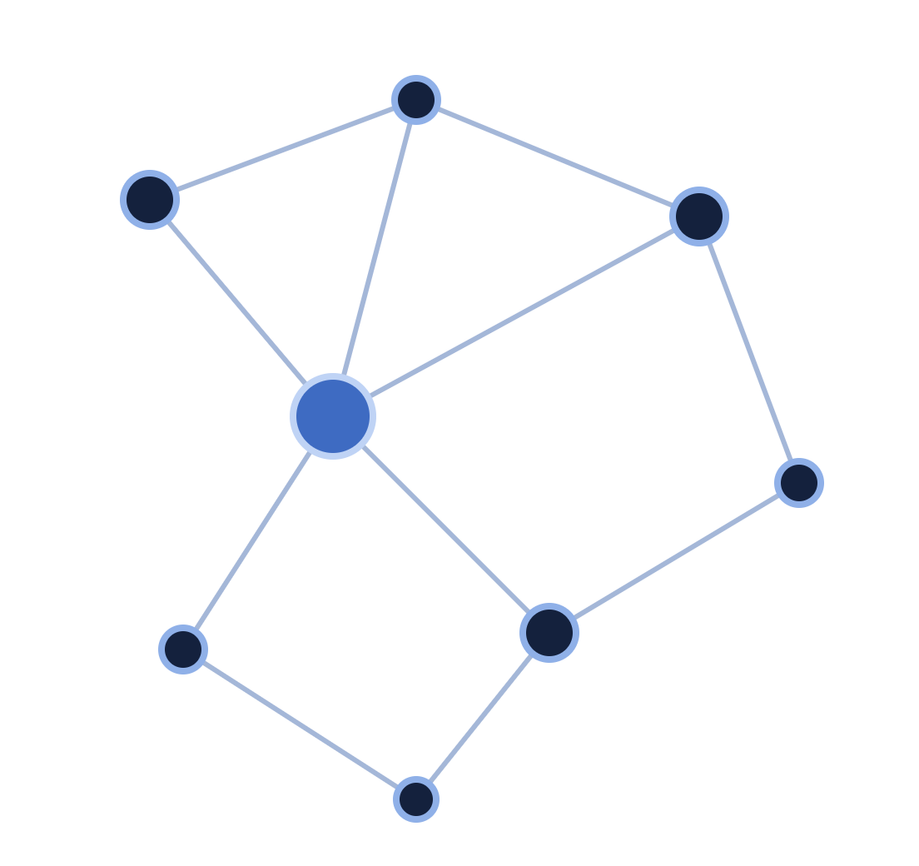
Replicating and Extending “How Powerful are Graph Neural Networks?”
PROJECT UPDATE · NOVEL PROJECT
COMP8240 Applications of Data Science · Session 2, 2026
Sobhan Salarian · Macquarie University
Code & data: github.com/SobhanSalarianCognitivo/Gin-Graph
Notes:
Hi, I'm Sobhan. This is my project update on replicating the Graph Isomorphism Network paper, and testing it on new data I built.

Slide 2




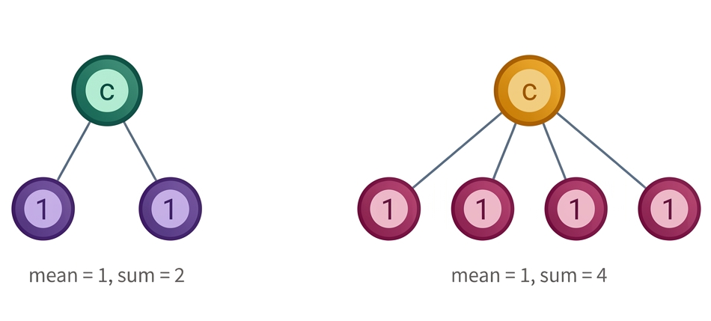

The paper and why we chose it
Theory
Venue
How Powerful are Graph Neural Networks?
Proves no message-passing GNN beats the WL test, and GIN reaches it
Published at ICLR 2019, a CORE A* venue
Keyulu Xu, Weihua Hu, Jure Leskovec, Stefanie Jegelka
Feasible
Rebuildable data
ICLR 2019 · CORE A*
Code ran unmodified on modern PyTorch; one 10-fold CV pipeline to re-point
IMDB benchmarks come from public movie metadata, so we can rebuild them
Core idea: why sum beats mean and max
A GNN updates each node by aggregating its neighbours, layer after layer, then pools all nodes into one graph vector
Mean and max can't tell some neighbourhoods apart. Sum can.
Paper's claim: GIN (sum + MLP) is as powerful as the WL test; GCN (mean) and GraphSAGE (max) are strictly weaker
Notes:
As a reminder, the paper is by Xu, Hu, Leskovec and Jegelka, published at A-star venue. The official code is public on GitHub. I chose it because it doesn't just propose a model, it proves a limit on what graph neural networks can tell apart. Its task is also easy to re-run on new data.
Quick idea of the method. A graph neural network updates each node by combining its neighbours' features. The paper shows the choice of combination matters. Mean or max can't tell two identical neighbours from four, but sum can. So GIN uses sum plus a small neural network, and the paper proves this matches the Weisfeiler-Lehman test, the theoretical ceiling.

Slide 3
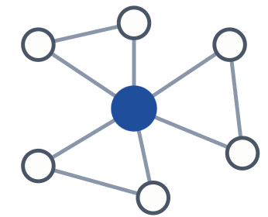

Original datasets
RECAP · DATASETS
The paper uses 9 benchmarks: 4 bioinformatics (MUTAG, PTC, NCI1, PROTEINS) and 5 social (COLLAB, IMDB-BINARY, IMDB-MULTI, REDDIT-BINARY, REDDIT-MULTI5K). We focus on the two IMDB sets, from Yanardag & Vishwanathan, Deep Graph Kernels, KDD 2015.
Dataset | Graphs | Classes | Labels | Avg nodes
IMDB-BINARY | 1,000 | 2 | Action vs Romance | 19.8
IMDB-MULTI | 1,500 | 3 | Comedy vs Romance vs Sci-Fi | 13.0
Node = an actor
Edge = co-starred in a film
Graph = an actor's ego-network
Label = genre
Why the paper uses them: no node attributes, so the model must rely on graph structure alone (node degree is the only input, via --degree_as_tag).
Why we chose these two: the only ones we can rebuild with new data: paper → our replication → same pipeline on new data. The other 7 were dropped on purpose (scope, not compute).
Notes:
The paper evaluates on nine standard graph-classification benchmarks. I focus on the two IMDB datasets. They come from the Deep Graph Kernels paper at KDD 2015. Each graph is an actor's collaboration network: nodes are actors, edges mean two actors appeared in a film together, and the label is the genre. IMDB-BINARY is Action versus Romance with a thousand graphs; IMDB-MULTI adds Sci-Fi and Comedy, with fifteen hundred. The paper uses them because they have no node features, so the model can only use structure. I chose these two because I can rebuild them from new movie data, giving a direct comparison.

Slide 4

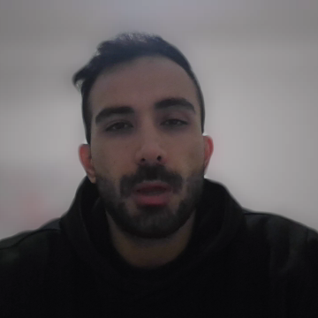
System architecture and our pipeline
Data
Features
CV split
GIN model
Model selection
TU-format text file, loaded with networkx
One-hot of node degree
10-fold stratified, seed 0
4 message-passing layers (5 incl. input)
run_gin.py (ours)
Each: sum + (1+ε)·self → 2-layer MLP (hidden 64) → BatchNorm → ReLU · GIN-0: ε = 0
Average the 10 folds' test curves → one best epoch → mean ± std there
--degree_as_tag
Readout: sum-pool at every layer → linear → dropout 0.5
Replication results vs the paper
Dataset | Paper GIN-0 | Our GIN (Colab T4) | Our GIN (uni re-run) | Paper GraphSAGE | Our GraphSAGE
IMDB-BINARY | 75.1 ± 5.1 | 74.4 ± 4.1 | 73.9 ± 2.7 | 72.3 ± 5.3 | 72.6 ± 3.0
IMDB-MULTI | 52.3 ± 2.8 | 50.5 ± 2.3 | 50.6 ± 2.7 | 50.9 ± 2.2 | 50.9 ± 2.8
Notes:
Here's the system. The official code reads graphs from a plain text file and uses each node's degree as its feature. It splits the data into ten folds. The model has four GIN layers with sum aggregation and a two-layer MLP, then sums the nodes at every layer to classify the graph. It trains for 350 epochs. The official script runs one fold at a time, so I wrote a driver that runs all ten folds and applies the paper's selection rule: average the curves, pick one best epoch, report mean and standard deviation there.
And the results. On IMDB-BINARY I got 74.4 percent against the paper's 75.1; on IMDB-MULTI 50.5 against 52.3. Both are within one standard deviation of the paper. We have that Colab and uni-re-run because on my laptop's CPU one dataset took about three and a half hours, so I moved to a Colab GPU, then to my university's GPU server when Colab's quota ran out .A second run on different hardware landed. GraphSAGE matched the paper almost exactly, and GIN still beats it on IMDB-BINARY. So the replication on the original data worked.

Slide 5
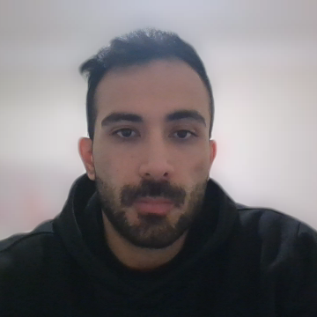
New data: existing and constructed
UPDATE · NEW DATA
Selected · not yet run
Built and run
Existing datasets not yet tried with GIN
Newly constructed: TMDb “IMDB-style” graphs
Source: The Movie Database (TMDb) API, with a free key
Candidates: ENZYMES, DD (TU benchmarks), OGB ogbg-molhiv, HuggingFace AIDS, Kaggle Tox21 / QM9, OpenAlex co-authorship
Recipe: mirrors the original Deep Graph Kernels construction (actors, co-starring edges, genre labels)
New data only: films released 2016 onward; the originals were built in 2015, so no overlap
Output: IMDBBINARY-NEW and IMDBMULTI-NEW, in the official code's exact input format, so zero code changes
First pick: ENZYMES / DD. Same TU text format, so they drop straight into the pipeline with no adapter.
Notes:
Now the new data. For an existing dataset, I've chosen ENZYMES or DD from the same benchmark family. They use the same file format, so no adapter is needed. That run is next. My main effort went into building a new dataset from scratch: I used the TMDb movie API to rebuild the IMDB benchmarks with films from 2016 onward.

Slide 6

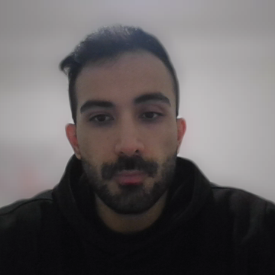
Construction progress, and a problem we found
1 · Collection
2 · Preprocessing
3 · Annotation
4 · Run
/discover/movie per genre + credits per film · 500 candidates per genre
Single genre · top-20 cast · drop < 5 actors · 0 duplicates
TMDb's curated genre; no manual labelling
Same GIN and GraphSAGE pipeline, unmodified
Dataset | GIN on original | GIN on new | GraphSAGE on new
Binary | 74.4 | 56.1 | 56.2
Multi | 50.5 | 40.9 | 41.0
Notes:
Progress: collection, cleaning and labelling are all done. Labels come from TMDb's own genre data. Running GIN on the new data, accuracy dropped sharply, to 56 and 41 percent. Rather than stop there, I checked my graphs, and found every single one is a complete graph. Each graph is one film's cast, and they all co-starred in that film, so everyone is connected to everyone. The only signal left is cast size, and a classifier using only node count scores exactly the same. So the drop comes from my construction, not from GIN.

Slide 7



Wrap-up and next steps
WRAP-UP
Done
Next
Official code running on 3 environments (CPU → Colab T4 → RTX 6000 Ada)
GIN replicated within 1 std of the paper on IMDB-BINARY and IMDB-MULTI; reproduced on a second GPU
GraphSAGE baseline matches the paper; a GPU bug in the official code fixed
Two new TMDb datasets built (996 + 1,492 graphs) and run; a construction flaw diagnosed
Rebuild the TMDb data as true actor ego-networks (an actor's co-stars across films, linked if they worked together). Check clique fraction and node-count baseline before training, then re-run GIN and GraphSAGE
Run an existing dataset (ENZYMES or DD) through the same pipeline
Investigate: misclassifications vs graph properties; a toy test mean/max can't separate but GIN can; optional GCN variant
Final report and repo clean-up (README with TMDb attribution)
github.com/SobhanSalarianCognitivo/Gin-Graph
Notes:
To wrap up: the replication worked and matches the paper, and the new data is built. Next, I'll rebuild it as real ego-networks, run an existing benchmark like ENZYMES, and dig into where GIN succeeds and fails. Thank you.

